Slide 1
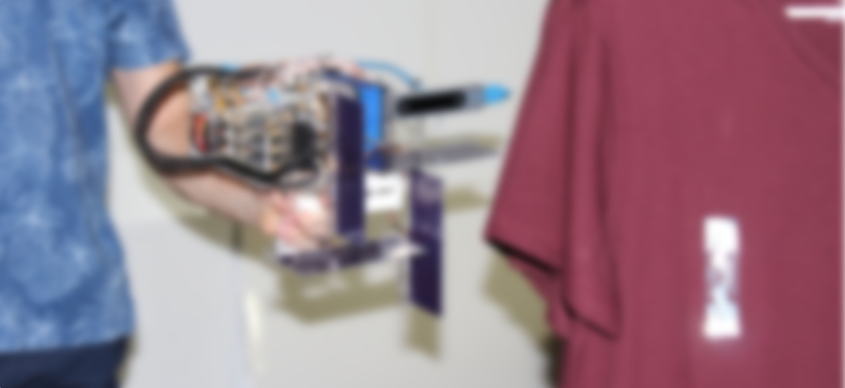
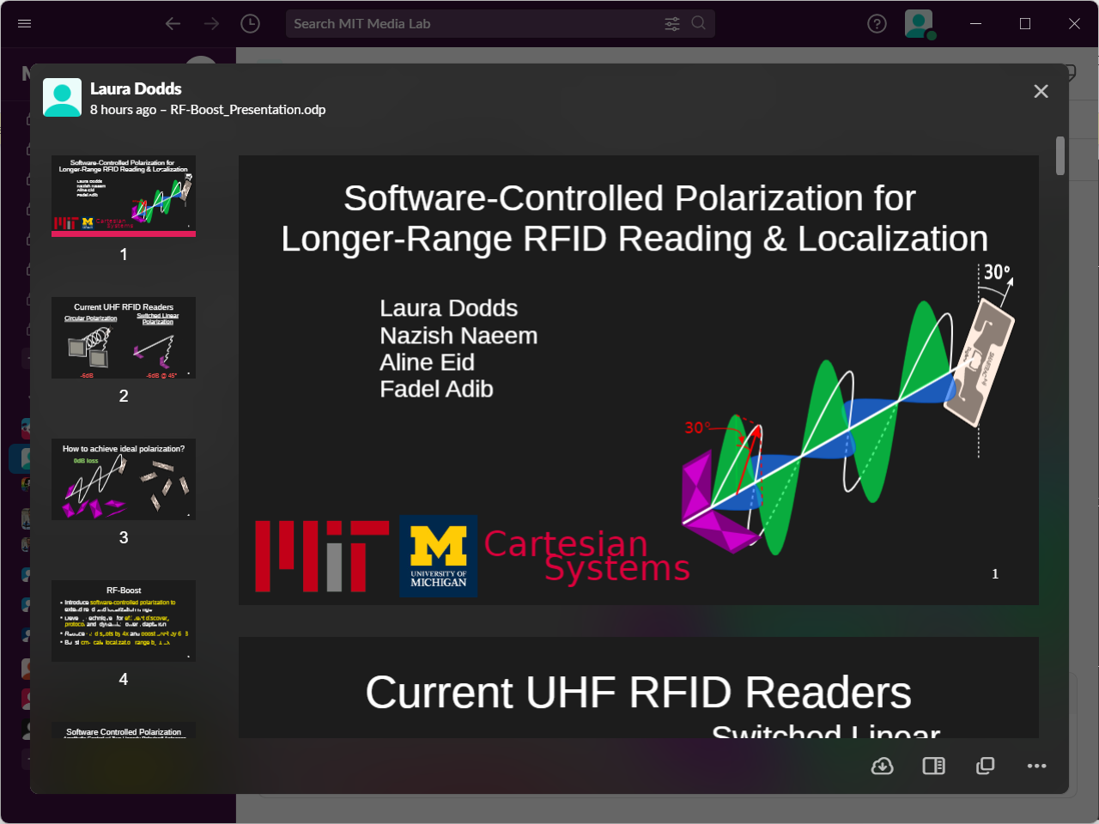
Fine-Grained RFID Localization with a Handheld Device via Complex Controlled Polarization
Laura Dodds, Isaac Perper, Aline Eid, Fadel Adib
Cartesian
Systems

Slide 2
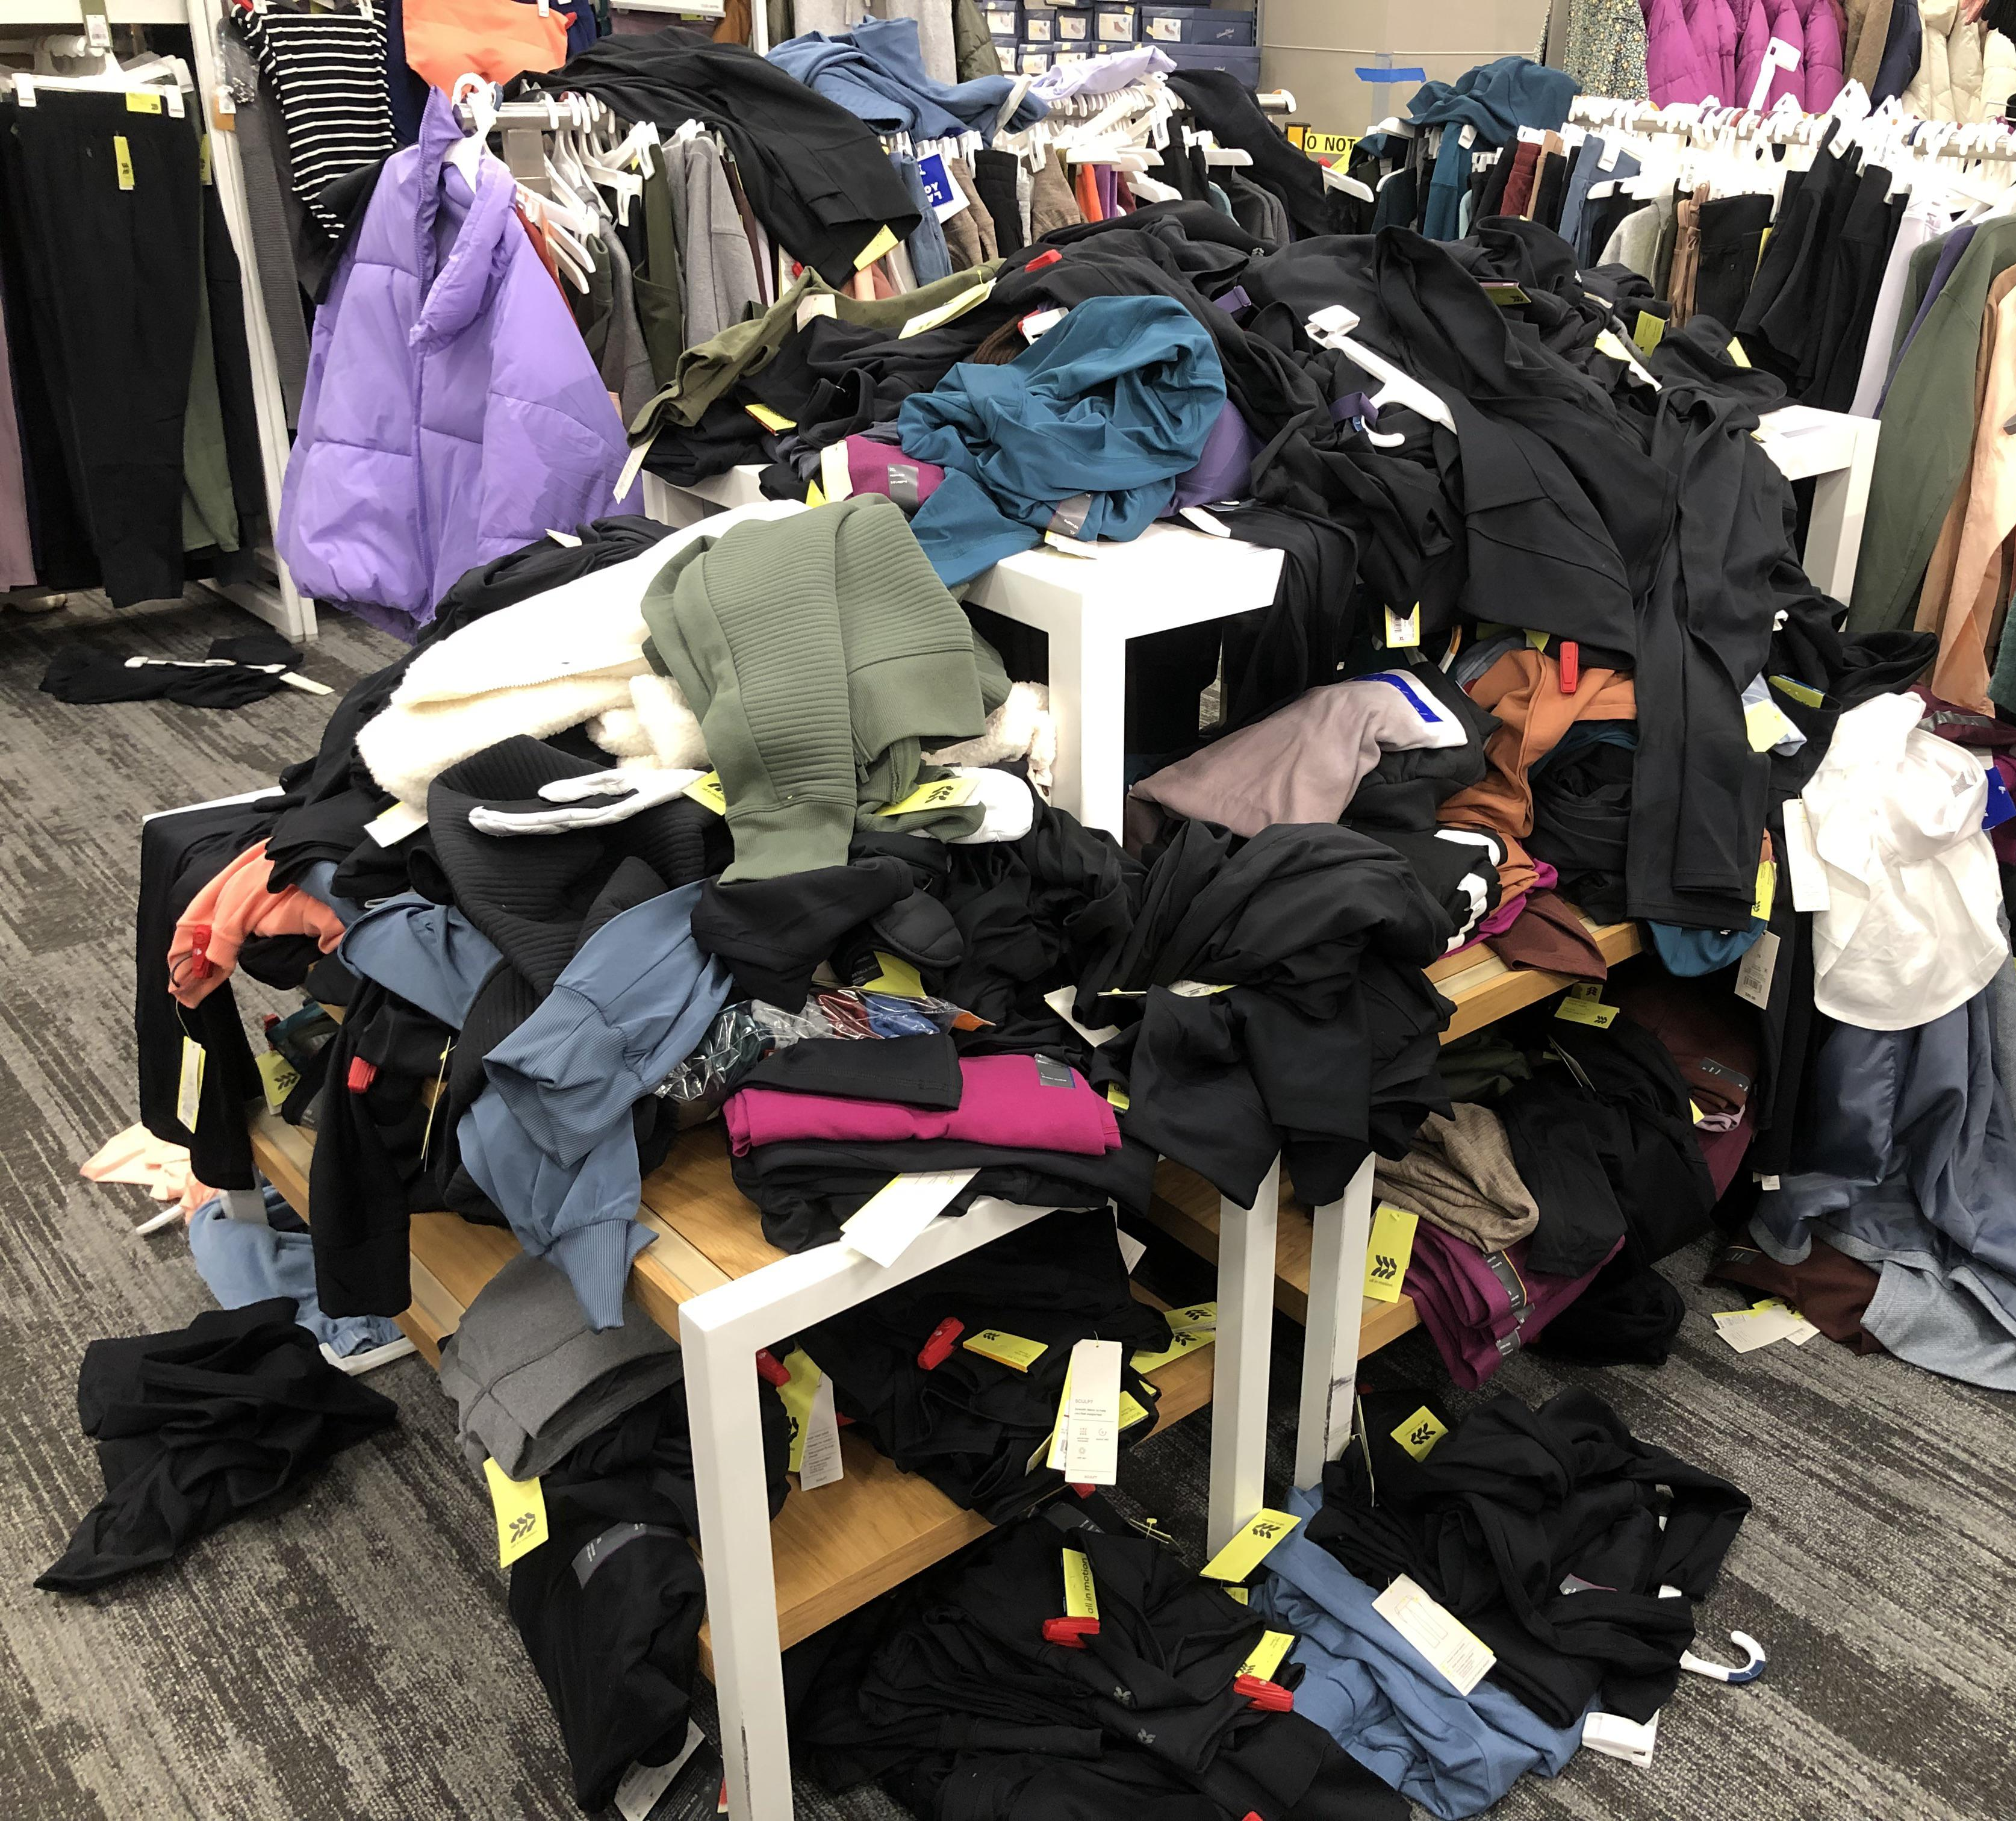

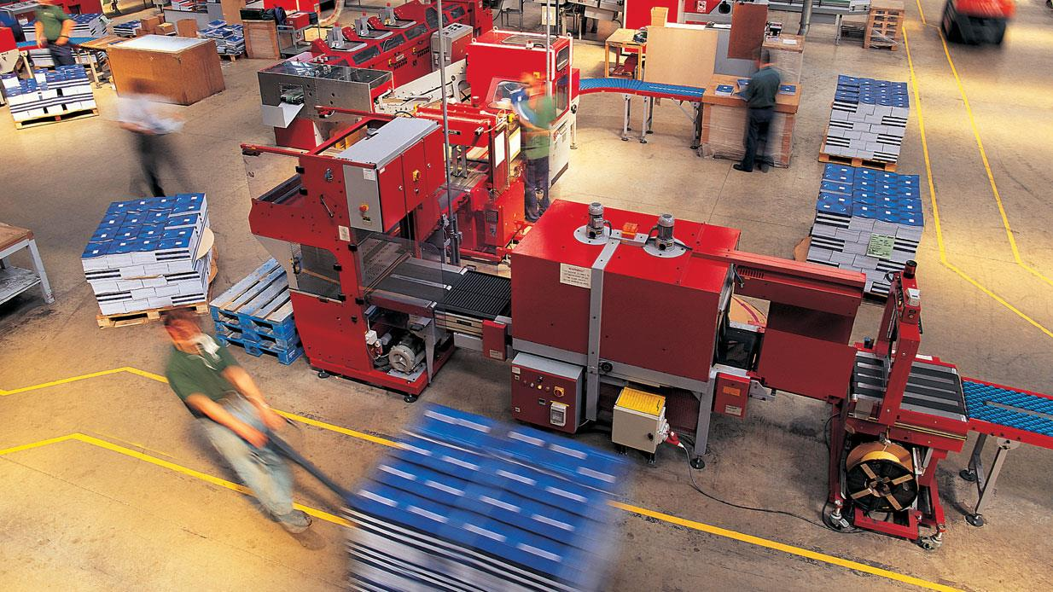
Fine-Grained RFID Localization has many applications
Retail
Warehouses
Manufacturing

Slide 3

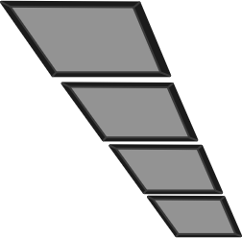
State-of-the-Art Localization
Infrastructure-Based
[MobiCom’17, SIGCOMM’13, SIGCOMM’15, …]

Slide 4
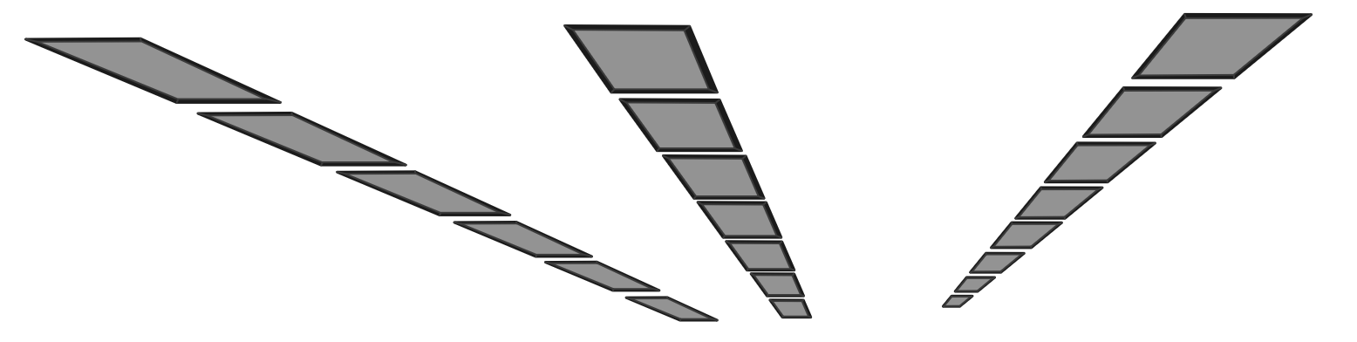
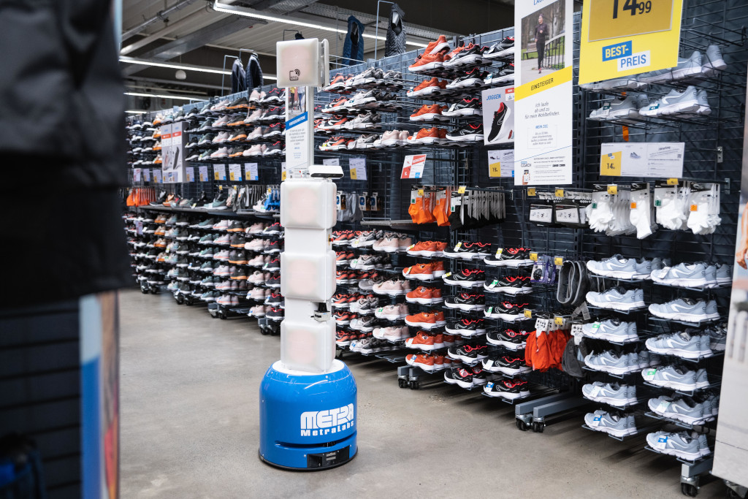
State-of-the-Art Localization
Infrastructure-Based
[MobiCom’17, SIGCOMM’13, SIGCOMM’15, …]
Robot-Based
[MobiCom’13, SenSys’21, RSS’22, …]
Very Expensive ($100k/store)
Expensive ($10s of k / robot)
Difficult to Scale (e.g., stairs)

Slide 5
The majority of RFID adoption uses handheld readers

Slide 6
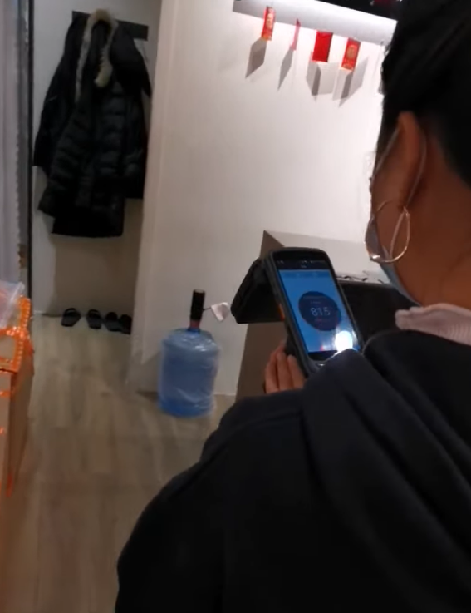
The majority of RFID adoption uses handheld readers
Affordable (~$1,000)
No Accurate Localization

Slide 7
POLAR
First fine-grained, handheld RFID localization system
Introduce techniques for complex-controlled polarization and joint tag discovery and localization
Achieves a median and 90th percentile of 9cm and 17cm, respectively

Slide 8
Problem: Existing handheld readers cannot localize tags across orientations

Slide 9
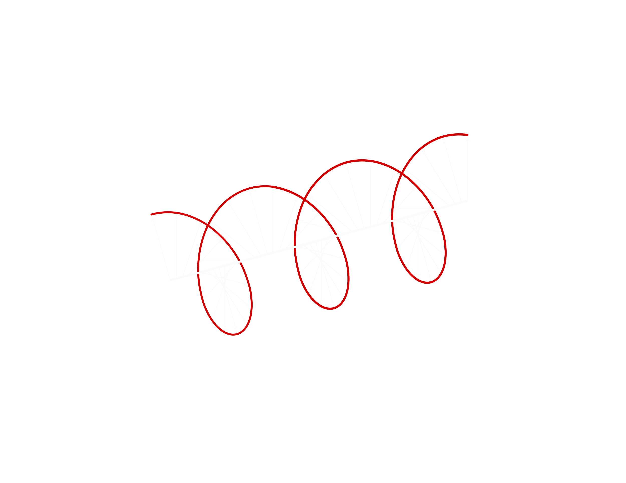

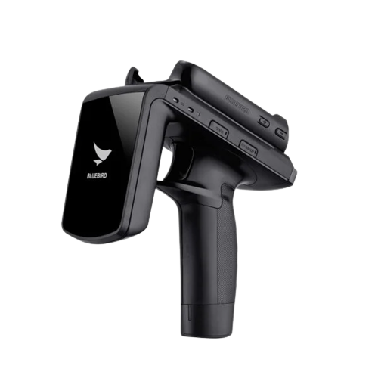
Localizing across orientation is challenging due to polarization
Existing portable readers use circularly polarized antennas

Slide 10
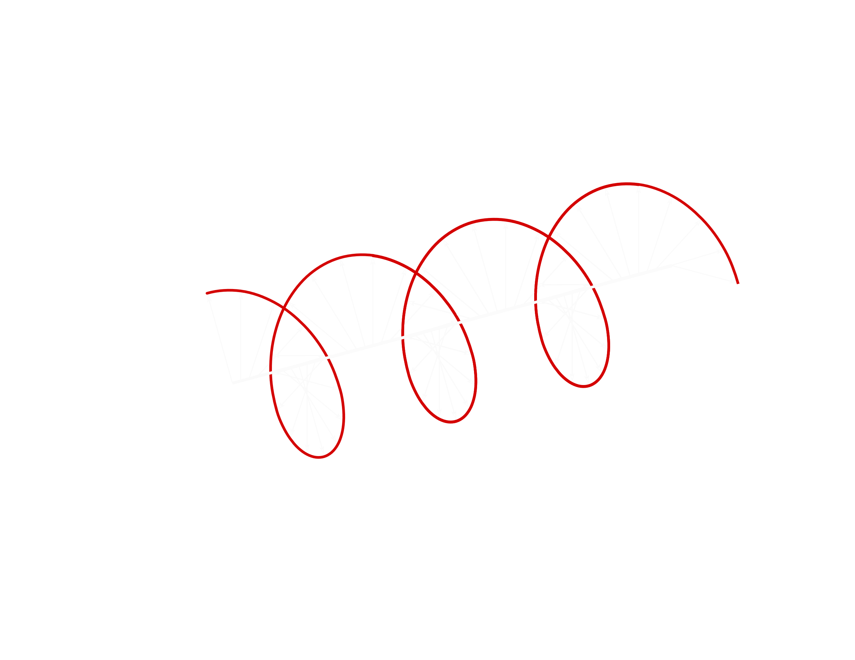
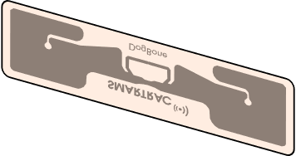
Localizing across orientation is challenging due to polarization
Existing portable readers use circularly polarized antennas
Circular polarization can read tags across orientation

Slide 11

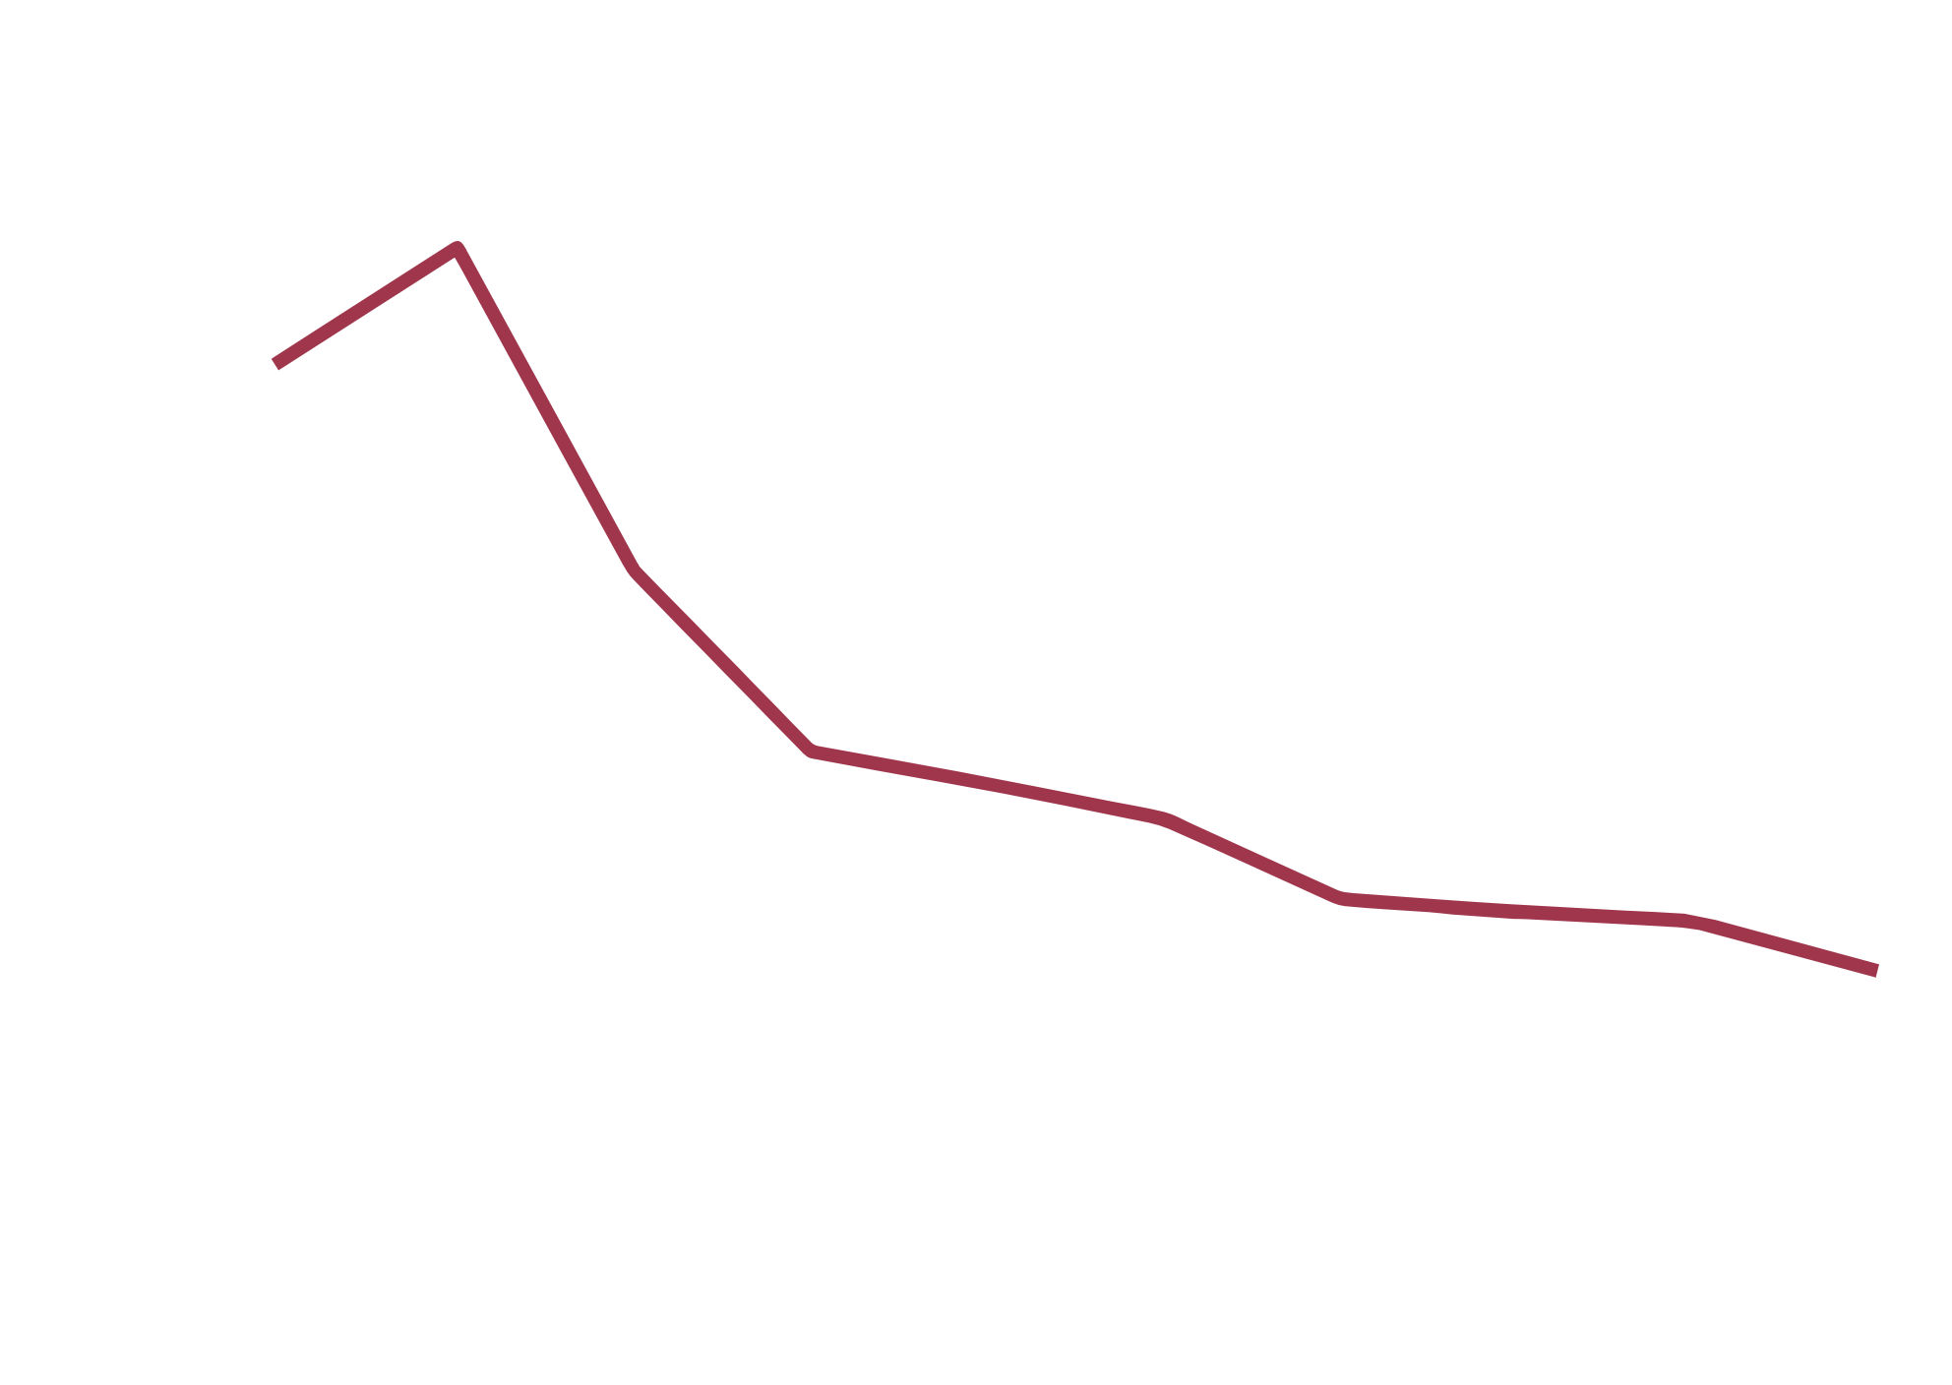

Localizing across orientation is challenging due to polarization
Existing portable readers use circularly polarized antennas
Circular polarization can read tags across orientation
…but they cannot perform accurate phase-based localization [ISPN ‘18, MobiCom ‘16, RFID-TA ’22]

Slide 12
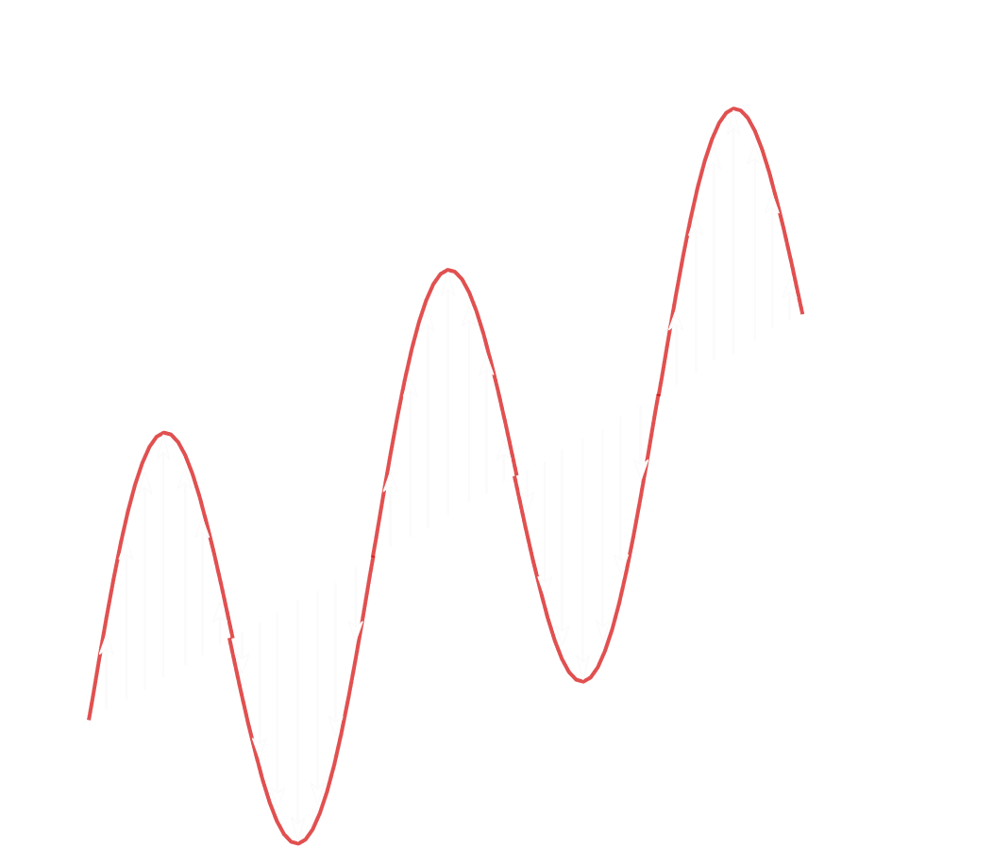
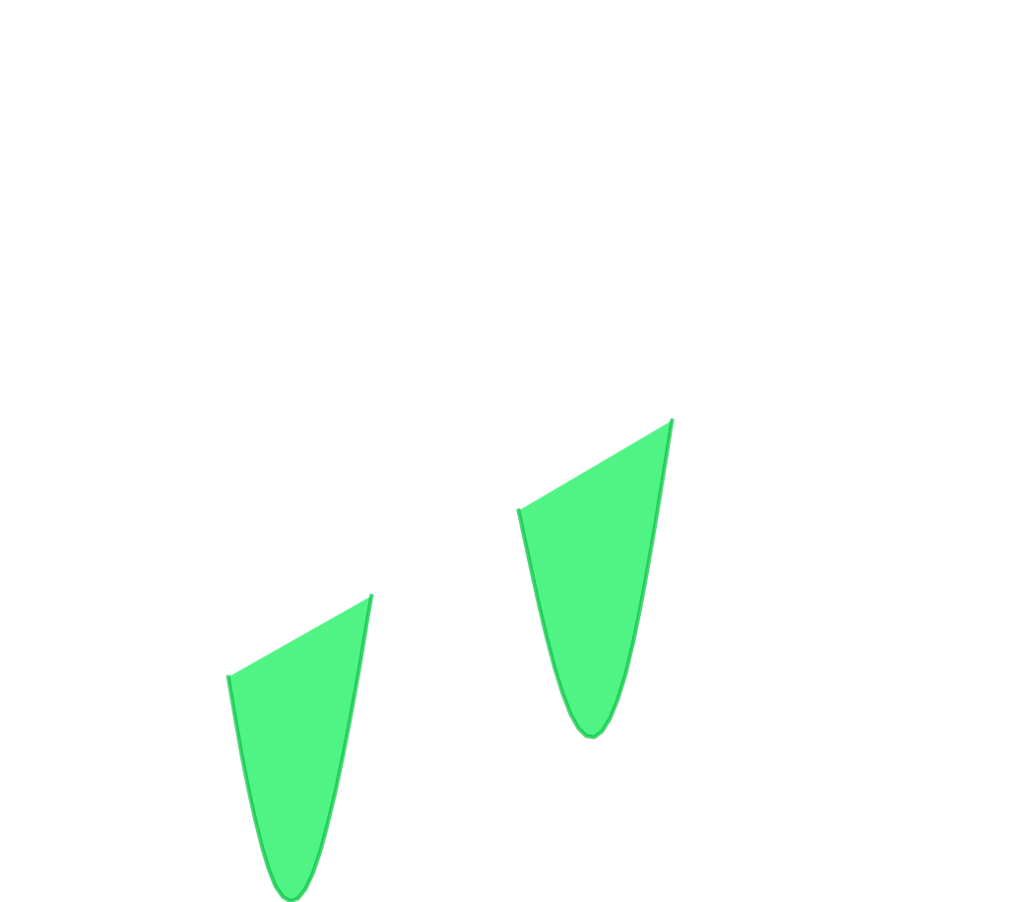
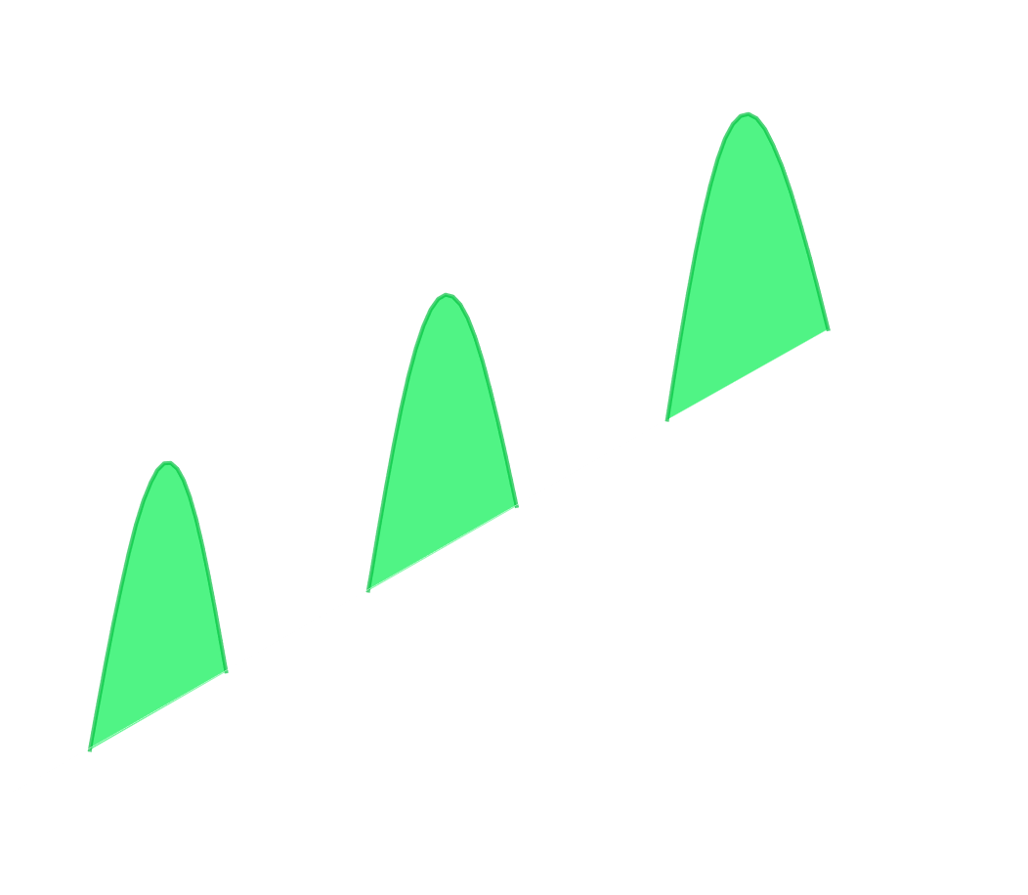

Solution: Introduce Complex-Controlled Polarization to Power and Localize across Orientation
Recall: Circularly Polarized
Linearly Polarized Antenna

Slide 13
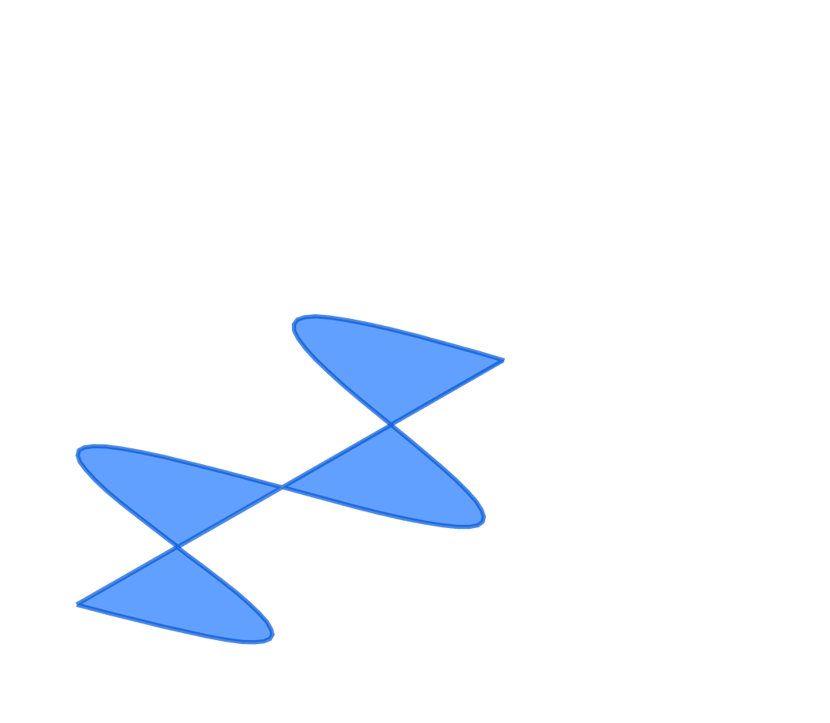

Solution: Introduce Complex-Controlled Polarization to Power and Localize across Orientation
C₁
Complex
Numbers
Linearly Polarized Antenna
C₂
(Shift by 90°)

Slide 14
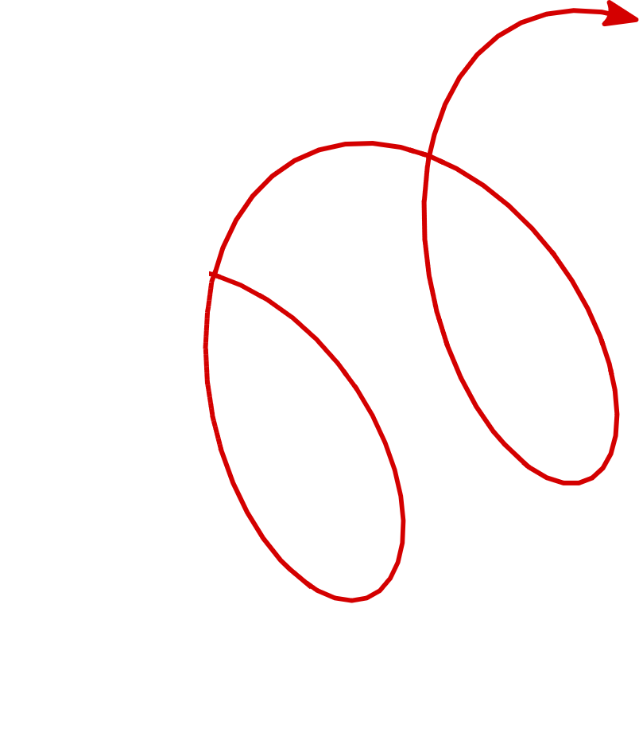
Solution: Introduce Complex-Controlled Polarization to Power and Localize across Orientation
C₁
Complex
Numbers
C₂

Slide 15
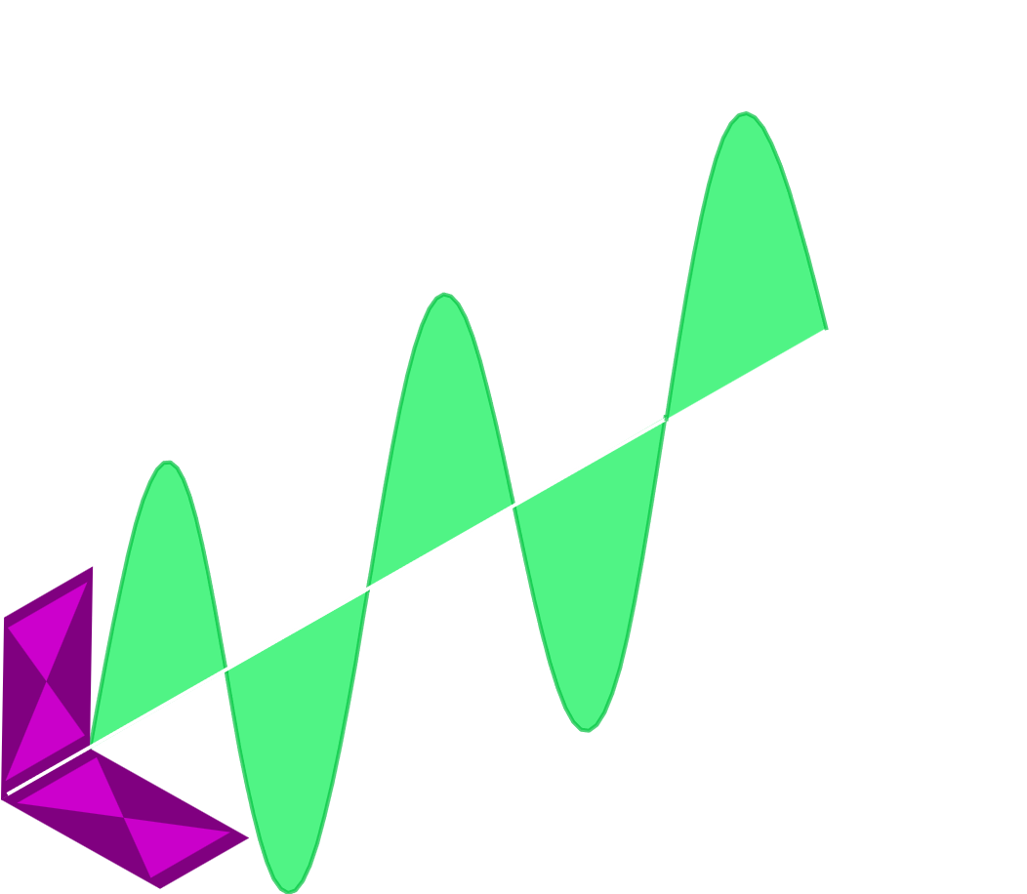

Complex-controlled polarization also enables generating arbitrary linear polarization
1
0

Slide 16
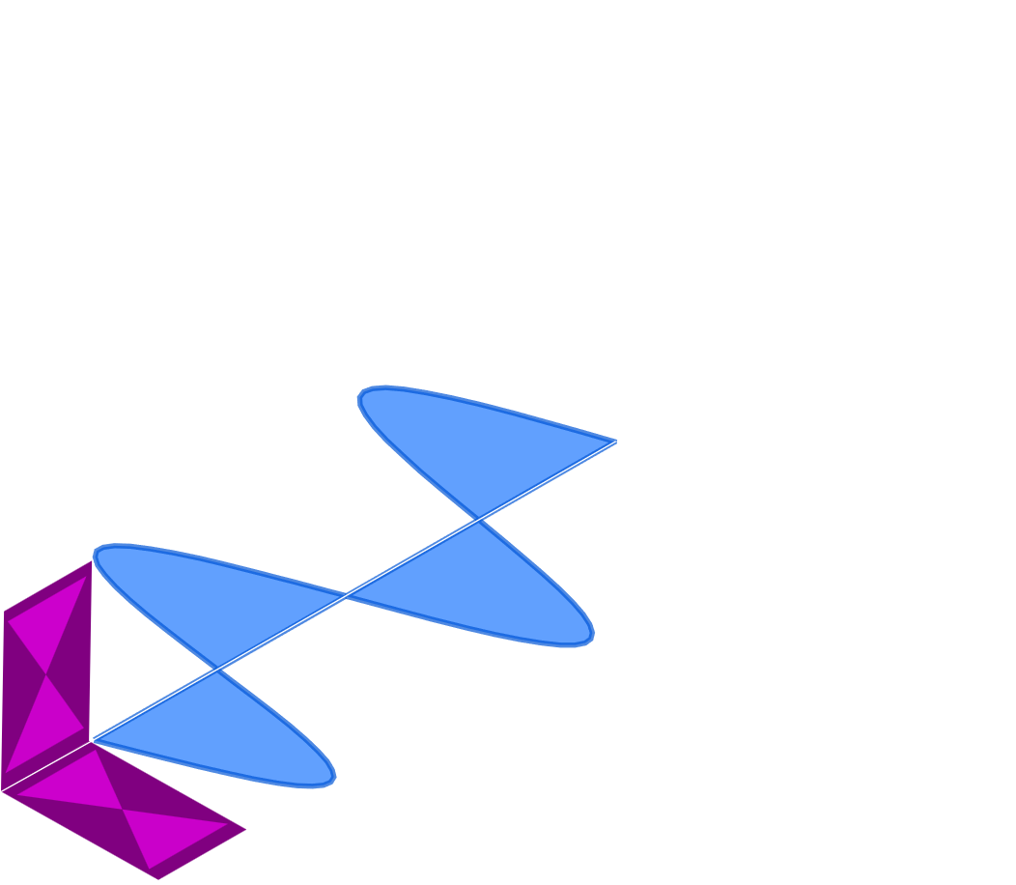
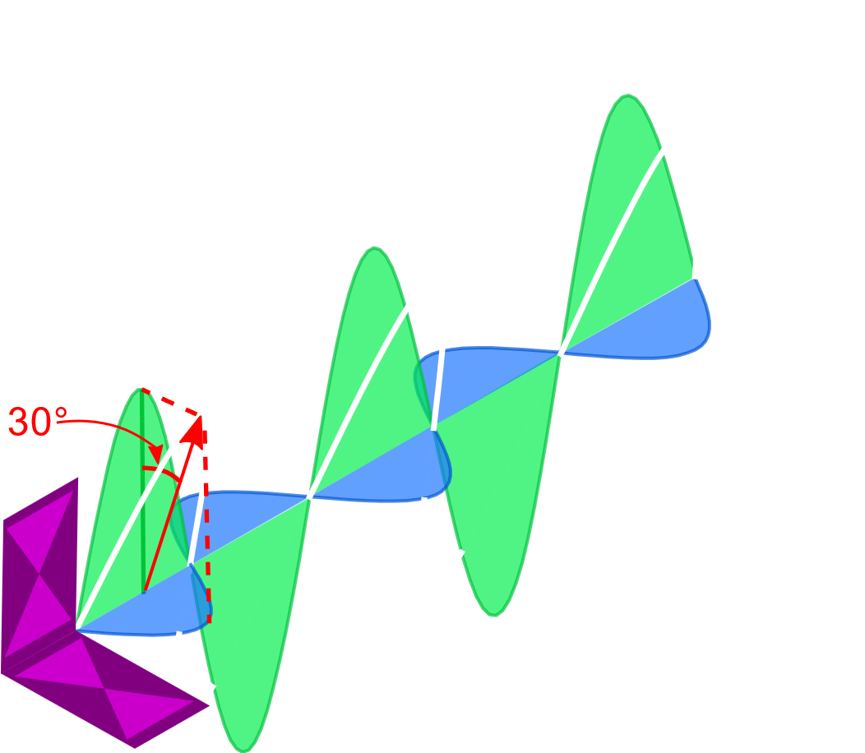

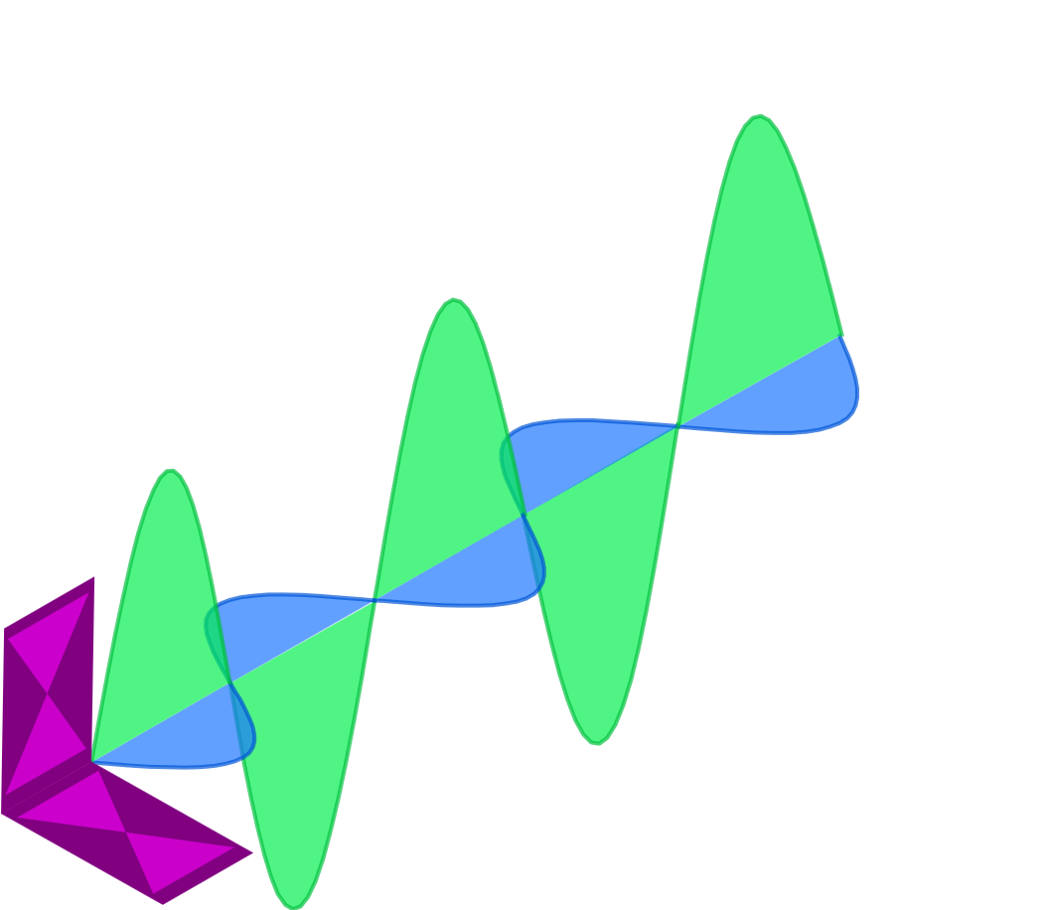
Complex-controlled polarization also enables generating arbitrary linear polarization
Linearly polarized signals measure consistent phases and enable accurate phase-based localization
0
1
cos(30°)
0
1
sin(30°)
Vertical polarization
Horizontal polarization
30° polarization

Slide 17
Complex-controlled polarization enables generating both circularly polarized and linearly polarized signals
Powers tags across orientations
Localizes tags across orientations

Slide 18
Complex-controlled polarization enables generating both circularly polarized and linearly polarized signals

Slide 19
Complex-controlled polarization enables generating both circularly polarized and linearly polarized signals
But how can we combine circular & linear polarization to efficiently power & localize tags?

Slide 20
Solution: Joint Tag Discovery and Localization (JTDL) Enables Zero-Overhead Localization

Slide 21

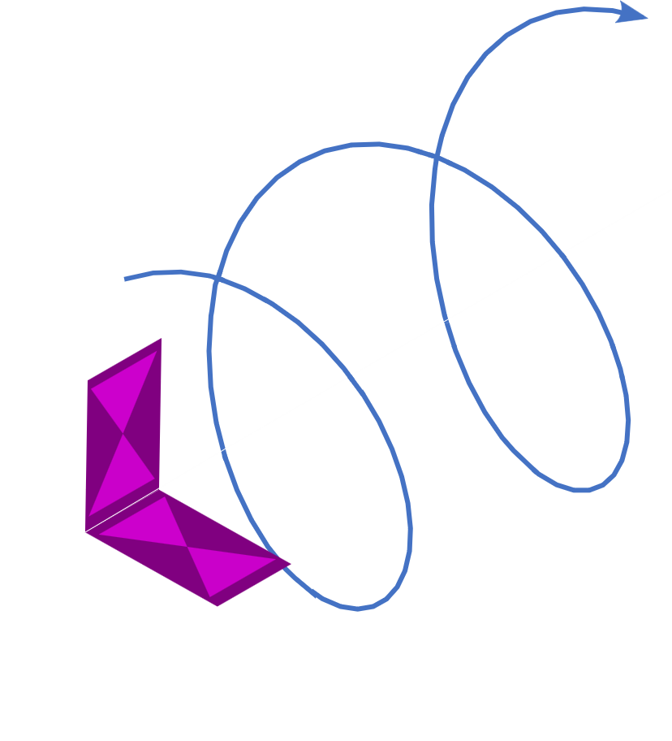
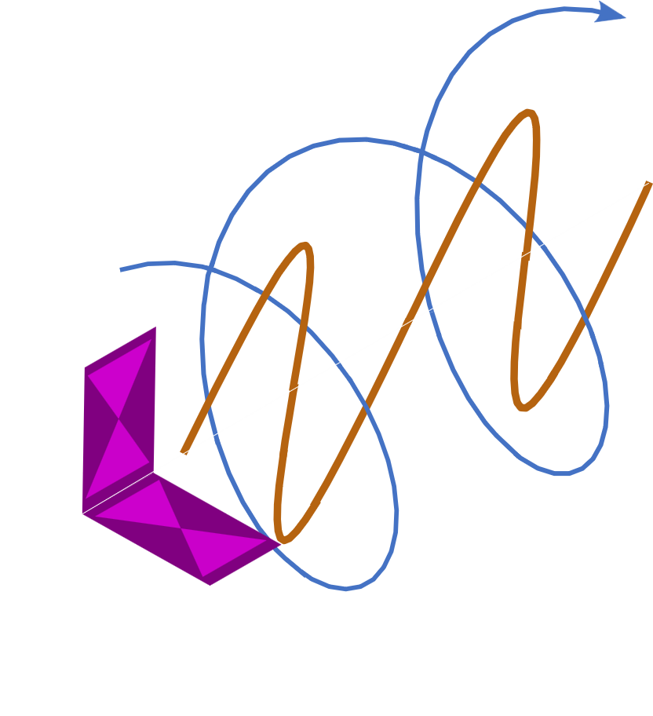
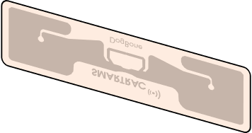
Solution: Joint Tag Discovery and Localization (JTDL) Enables Zero-Overhead Localization
POLAR can jointly power & localize across orientations
f_{power}
Estimates phase by multiplexing linear transmissions & performing polarization projection at the receiver
(details in the paper)
f_{localize}
f_{power}
f_{localize}

Slide 22
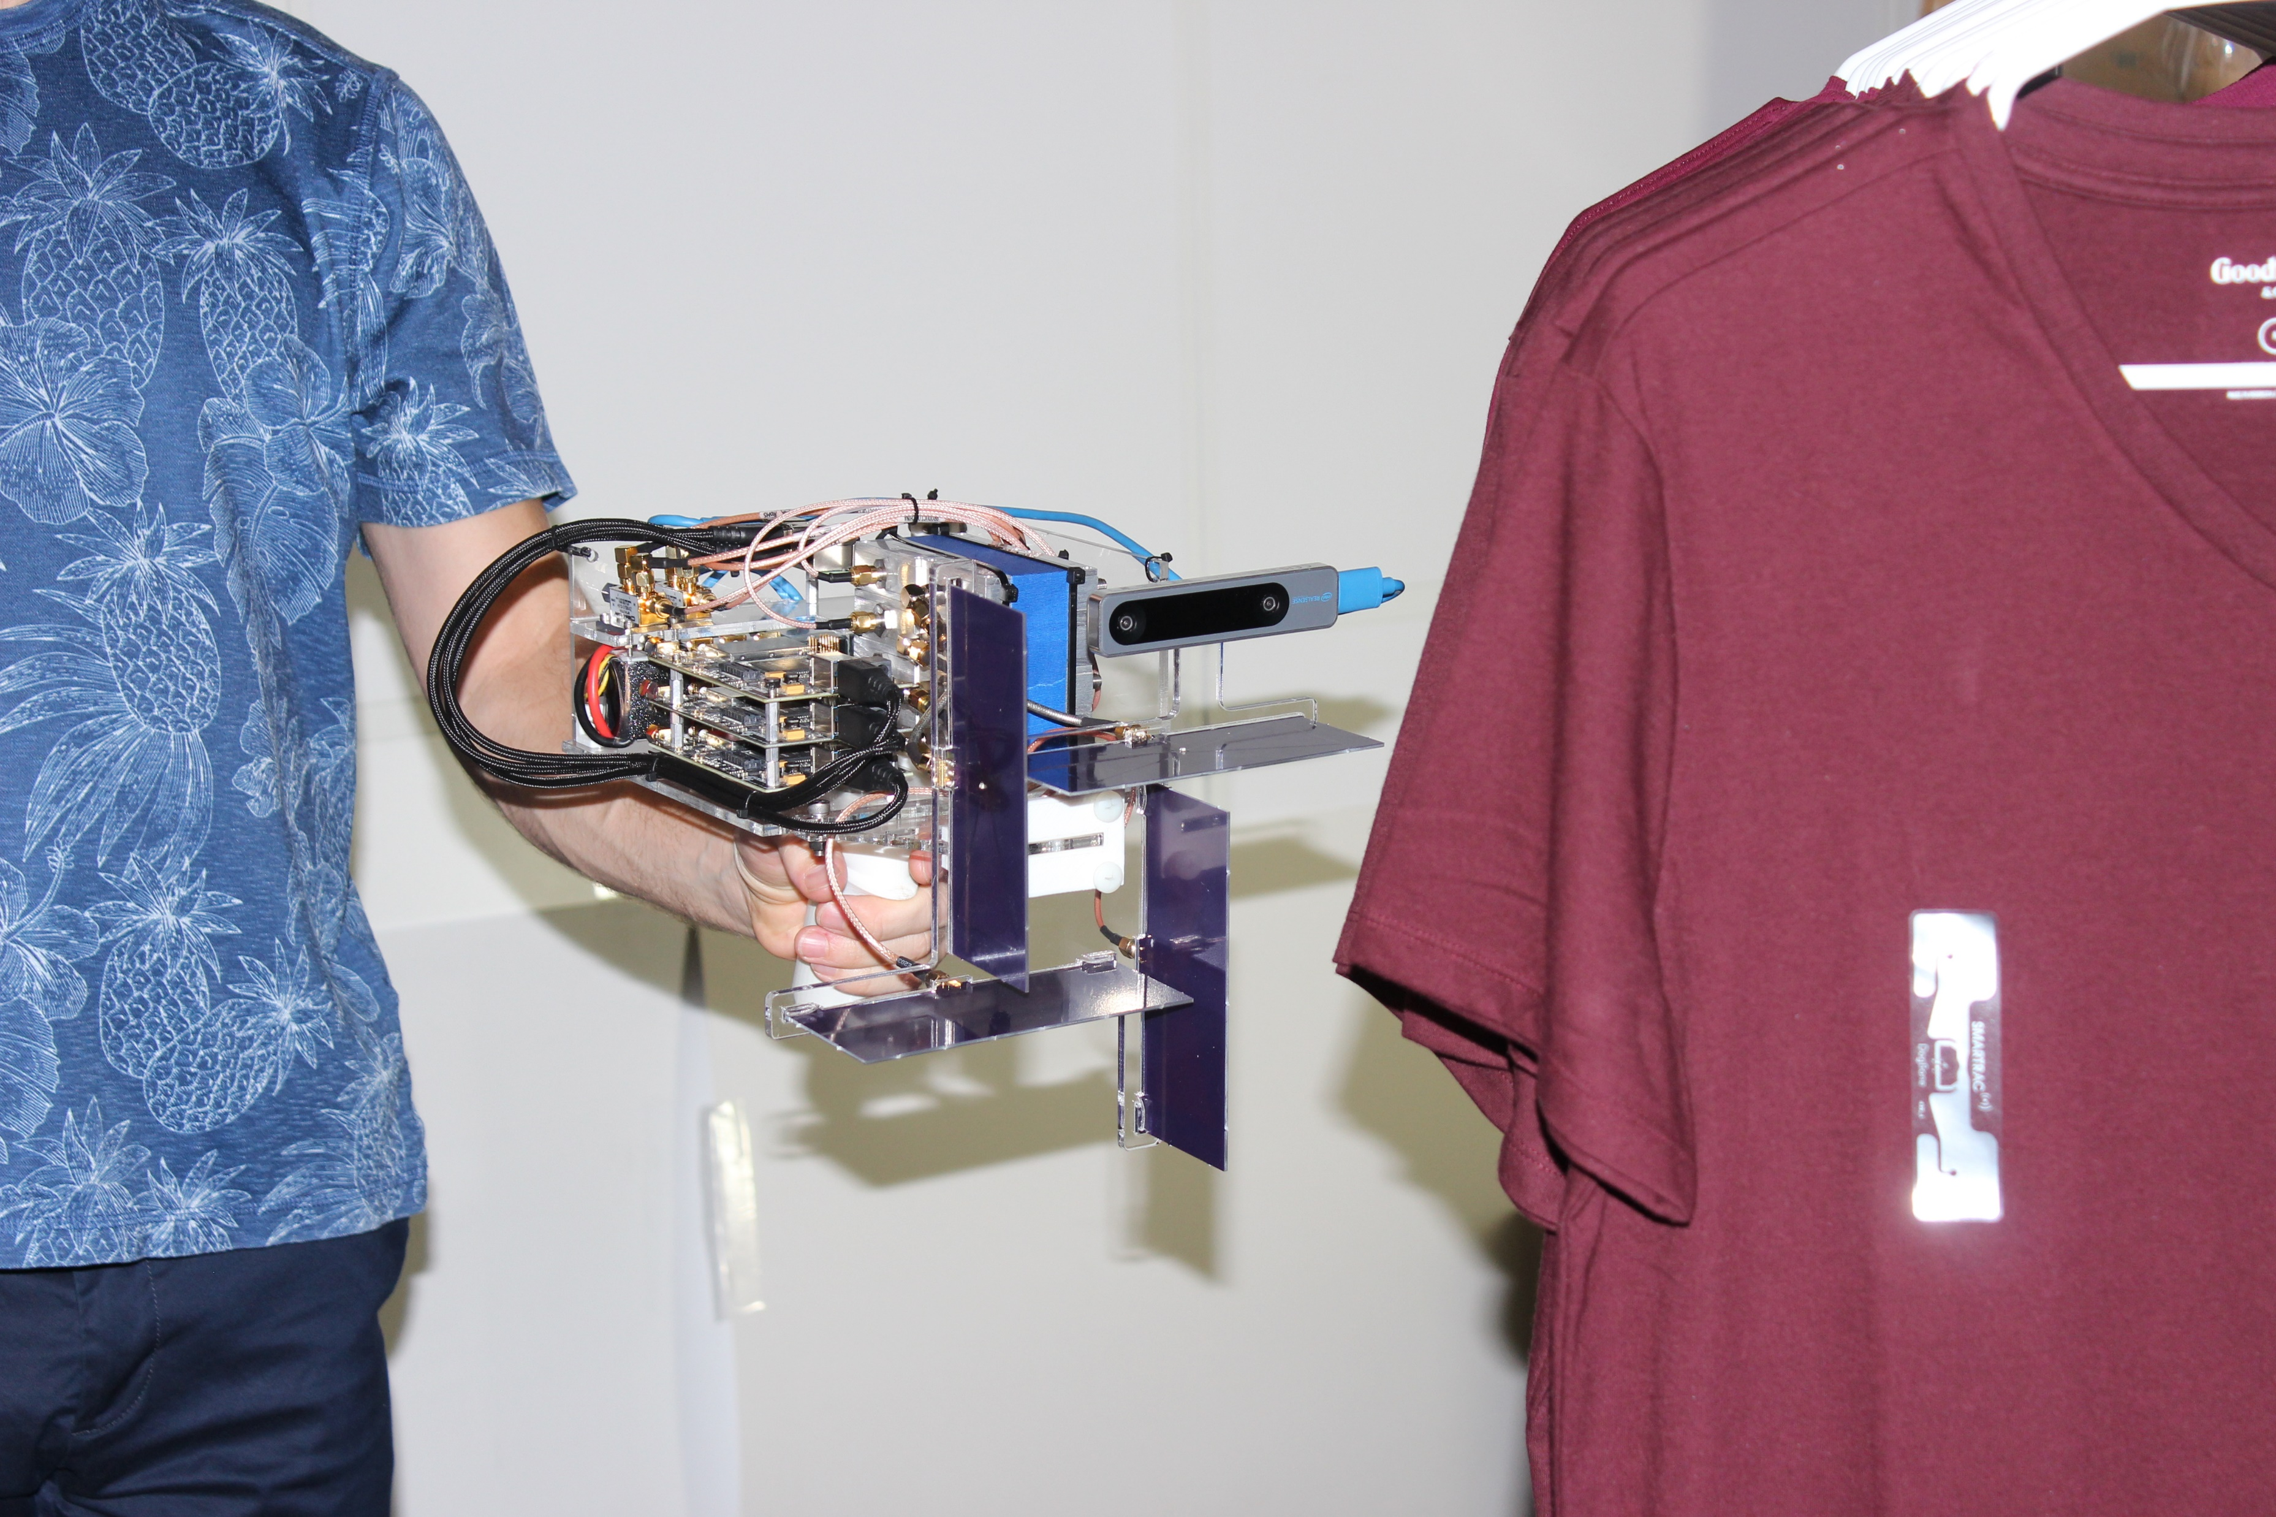
Implementation
BladeRF software defined radios to apply complex-control polarization
Raspberry Pi
EPC Gen 2 Protocol
Intel RealSense camera for self-tracking
Custom-designed bowtie antenna
Smarttrac RFID Tags
Intel RealSense Camera
RFID Tag
Software
Defined
Radios
Antennas
System can be built for <$1000

Slide 23


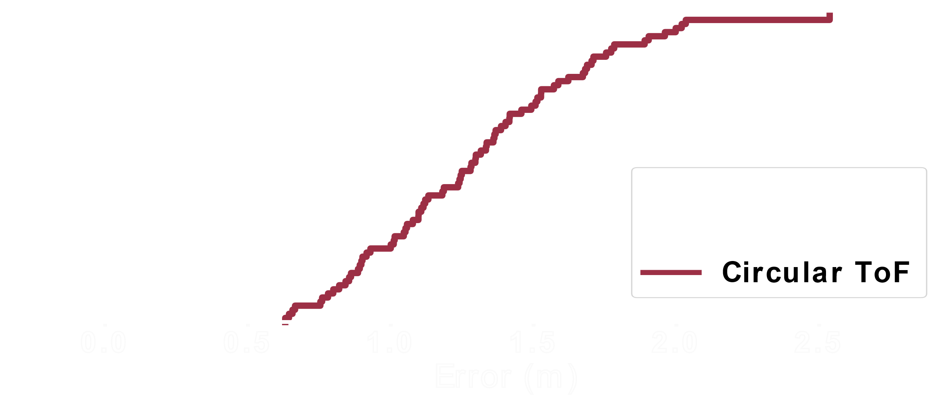
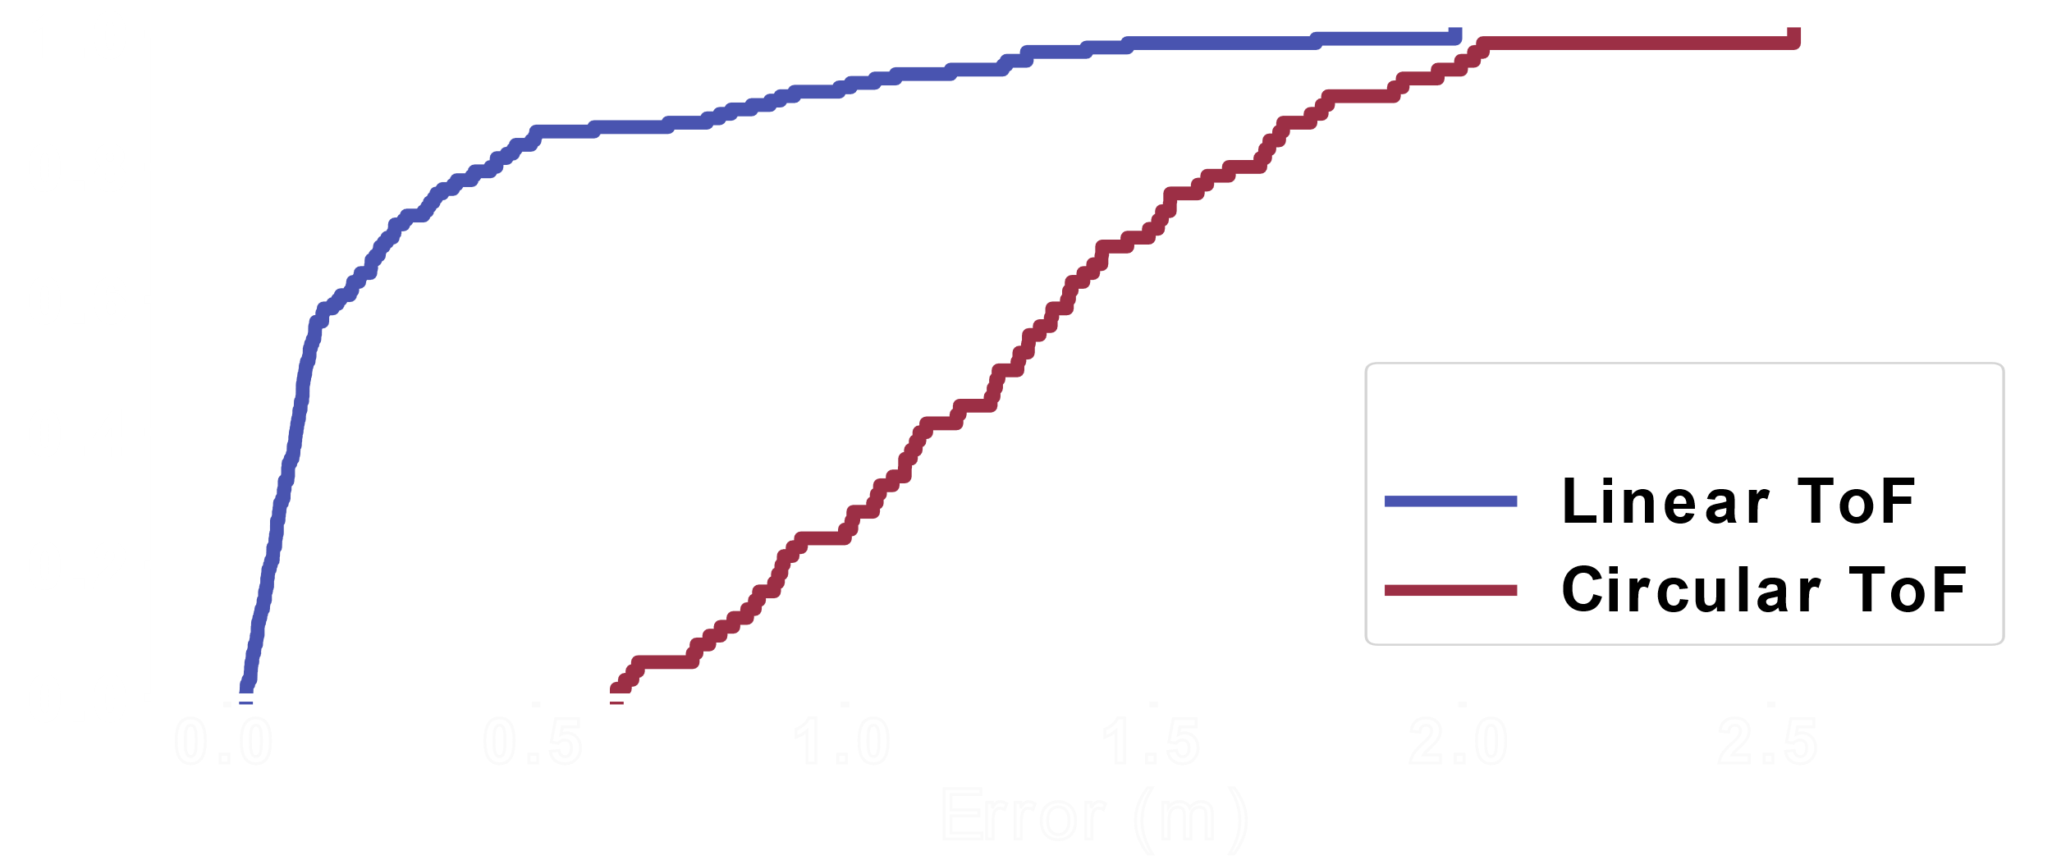
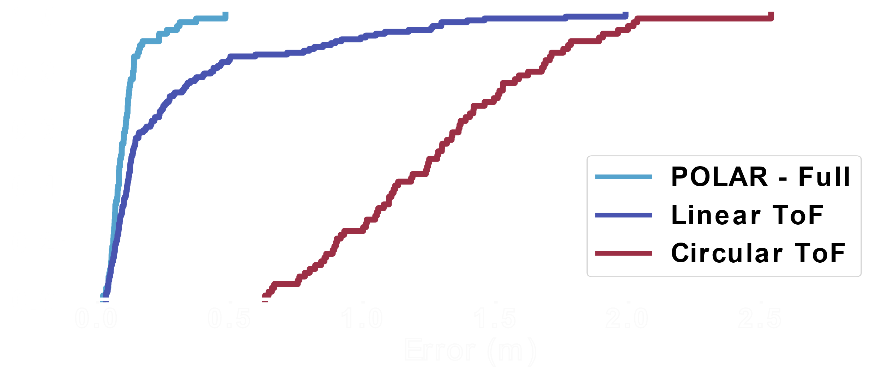
3D Localization Accuracy
Place >25 tags at angles from 0° to 360°
Over 75 location measurements in total
Moved device around the environment
17cm
88cm
POLAR achieves fine-grained (sub-10cm) localization accuracy across orientations significantly outperforming a circularly polarized baseline
9cm
1.28m

Slide 24


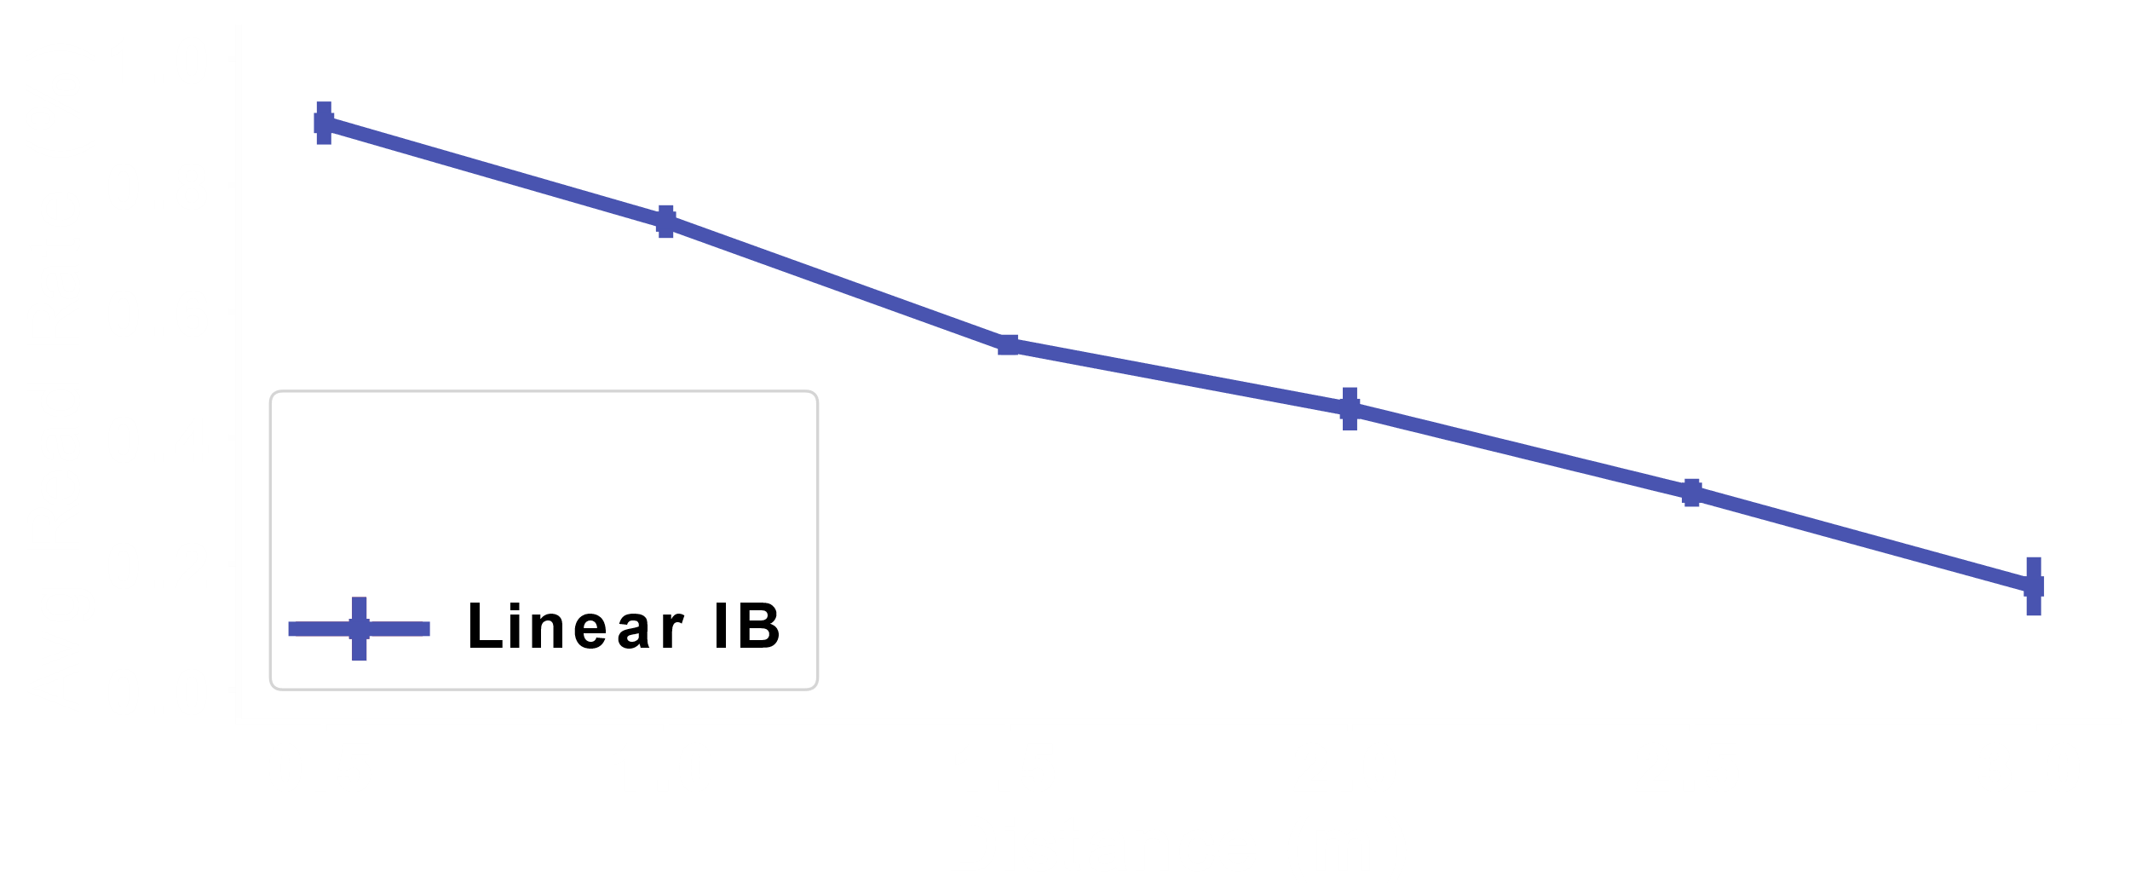
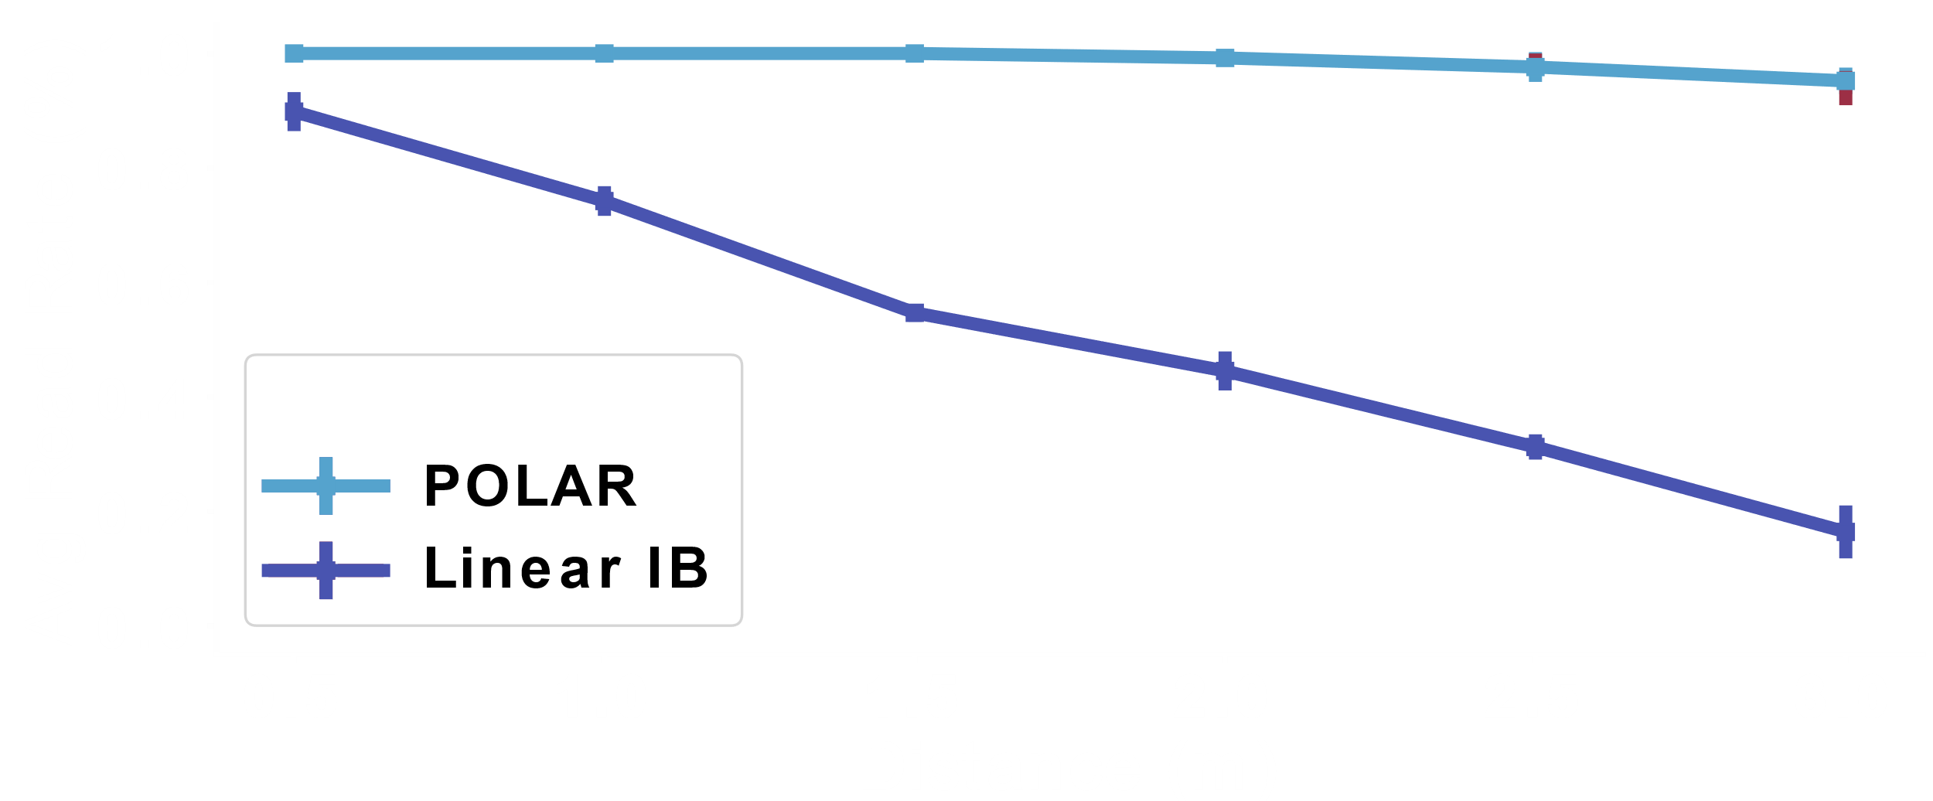
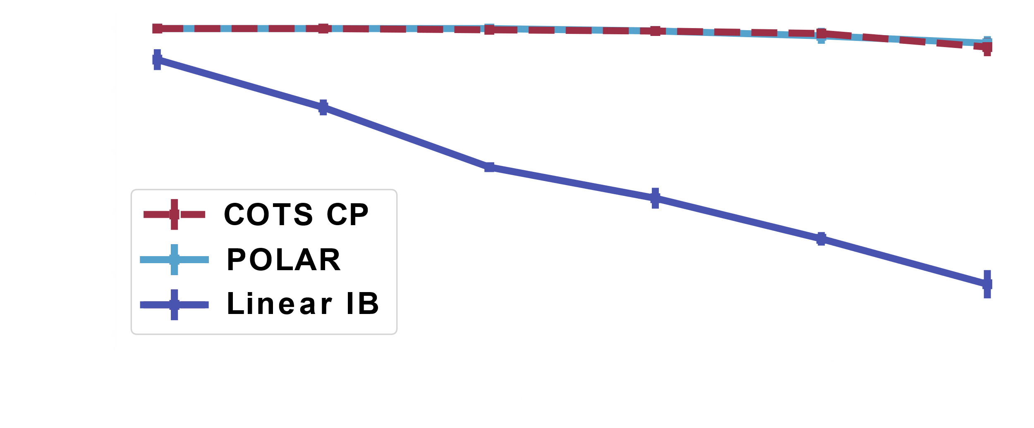
Read Rate vs Distance
Place >30 tags at angles from 0° to 360°
Moved device around a single plane
Varied the distance between tag plane and device plane
Measured read rate: % of tags that the device could read
POLAR can read tags across orientations and distances significantly outperforming a linearly polarized baseline

Slide 25
Conclusion
First fine-grained, handheld RFID localization system
Complex-controlled polarization and Joint Tag Discovery and Localization to overcome tag orientation
Achieves fine-grained localization (9cm)
10x improvement in accuracy over past handheld-based RFID systems

